Slide 1


Project name: ADC Resolution vs. Sensorless Motor Control Performance Team members: Tamara Basfar, Cristian Ornelas, Tyler Hawkins, John King
Sponsors: Texas Instruments(Kevin Allen)

Slide 2
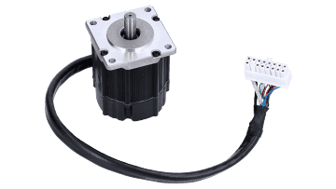
Problem Statement
Conventional motor systems usually depend on sensored motor control to supply feedback, but these sensors can malfunction, particularly in unfavorable environments. There is an increasing need to simplify systems, improve dependability, and decrease cost expenses. On the other hand, with sensorless motor control, the drawback is that there is a lack of feedback at low speeds during startup.
Solution?
Notes:
Christian
2 minute

Slide 3
Project Description
Solution proposal: Develop software for sensorless motor control on one of TI’s newest c2000 devices with enhanced features, and conduct an array of tests on the software to determine what set of sensorless control parameters are most effective.
Notes:
Case
2 minute

Slide 4
Project Scope Update
Misunderstanding of project goals: original project did not possess enough technical merit.
Original project called for porting the code and testing.
Expanded project will achieve this, as well as test an sensorless motor control written by our groups members.

Slide 5
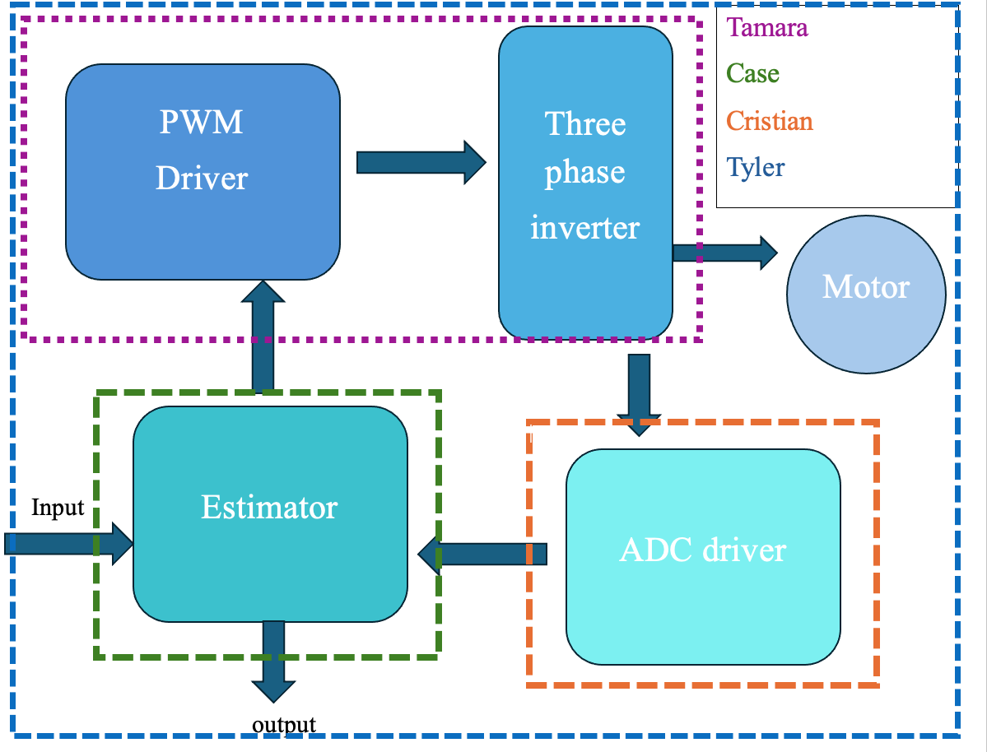
Diagram of subsystems and interface
Notes:
Tyler->Cristian->Case/Tamara

Slide 6
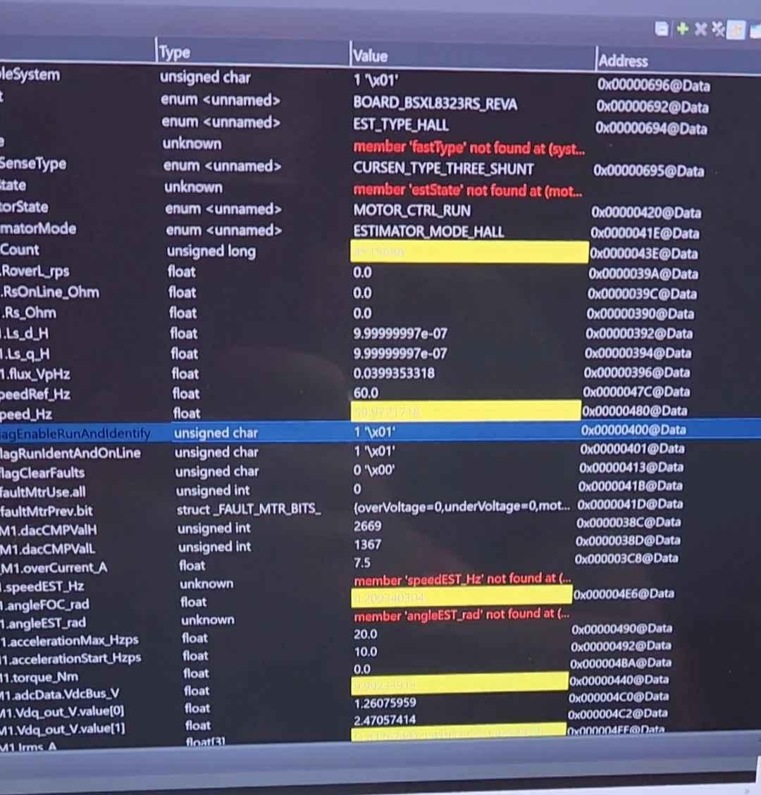
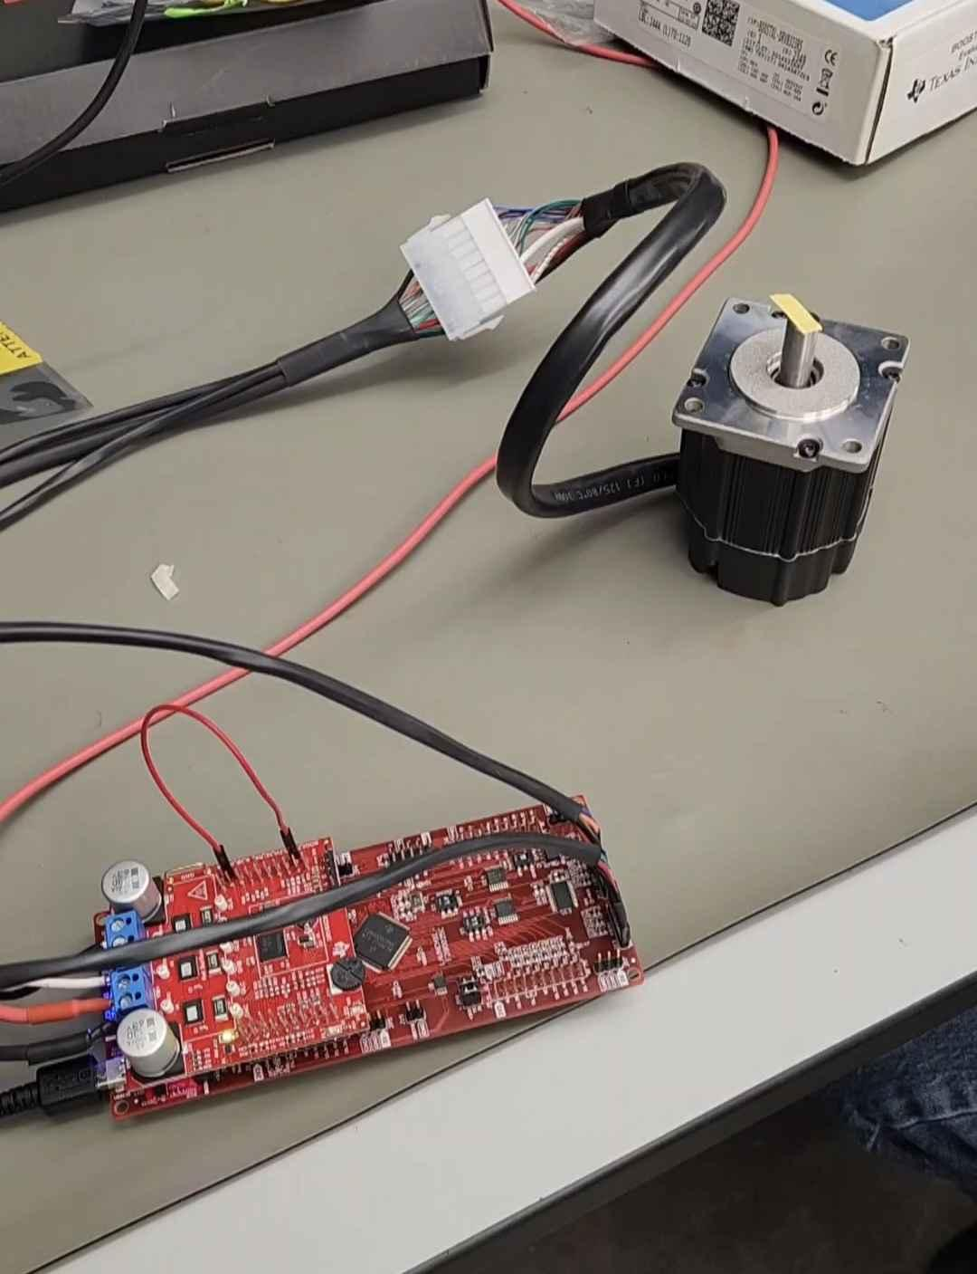
-Solution Porting-
Tyler Hawkins
Accomplishments since the last presentation <15-20> hrs | Ongoing progress/problems and plans until the next presentation
Able to run solution on older F28002x board Ordered capacitors for sensorless testing on old board Created and began updating universal Motor Control Directory for the F25P65x Board Updated projectspec file | Updating the memory maps in the cmd files for the F28P65x Board Adding DRV8300 driver board support Add sysconfig support

Slide 7
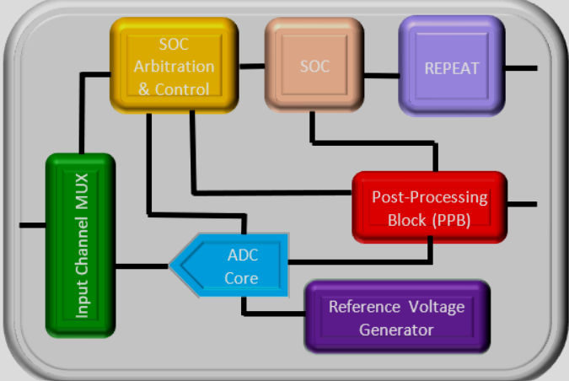
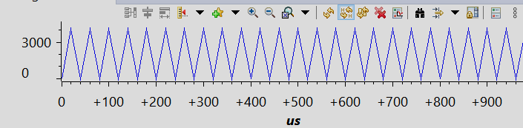
-ADC Driver-
Cristian Ornelas
Accomplishments since the last presentation <16-17> Hours | Ongoing progress/problems and plans until the next presentation
Compile and run “hello world” LED introductory project Configure and run starter ADC driver Configure and run starter sysconfig. project. Begin planning ADC driver module code | Complete and compile ADC module code Understand all of the required parameters for ADC driver Understand how to enable oversampling Add sysconfig. support
Real Time ADC Conversion

Slide 8
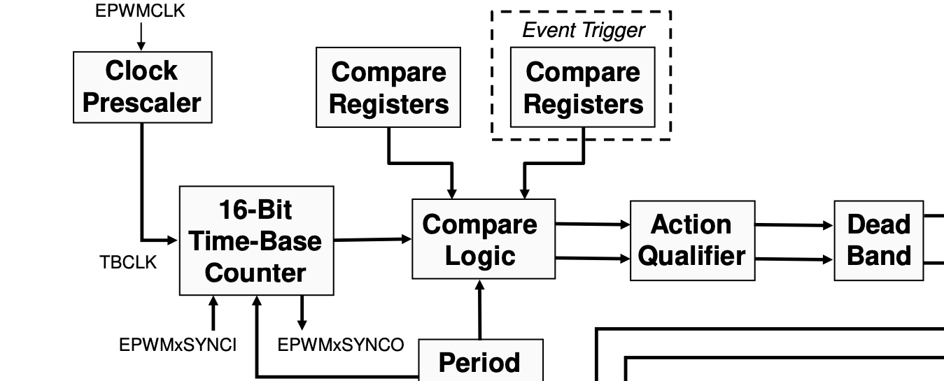
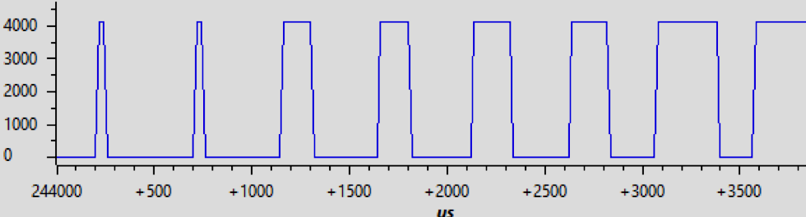
-PWM/ Inverter-
Tamara Basfar
Accomplishments since the last presentation <16> hrs | Ongoing progress/problems and plans until the next presentation
introduction project configured and ran simple pwm driver that can be added on as the project progresses (modulation shown below) planning code for more complex pwm functions (blocks shown below) | understanding space vector modulation to know what exactly the pwm will be taking in during open loop control finishing up functions code setting required parameters for the sensorless motor control adding sysconfig support
duty cycle modulated from 5% to 95%
Notes:
Time-Base Submodule: Controls the counter that tracks time and determines the frequency and period of the PWM signal. The counter can count up, down, or both (up-down), which controls whether the waveform is symmetrical or asymmetrical.
Counter-Compare Submodule: Continuously compares the counter value to pre-set values (CMPA, CMPB, etc.). When the counter matches these values, events are triggered (e.g., change in output or starting an ADC conversion).
Action-Qualifier Submodule: Determines what actions to take when match events occur (e.g., set PWM pin high or low, toggle pin). Actions can be set independently for up-count and down-count modes.
Dead-Band Submodule: Delays the switching of the PWM signal to avoid short circuits, especially when switching devices like MOSFETs that turn on faster than they turn off. You can set rising and falling edge delays.

Slide 9
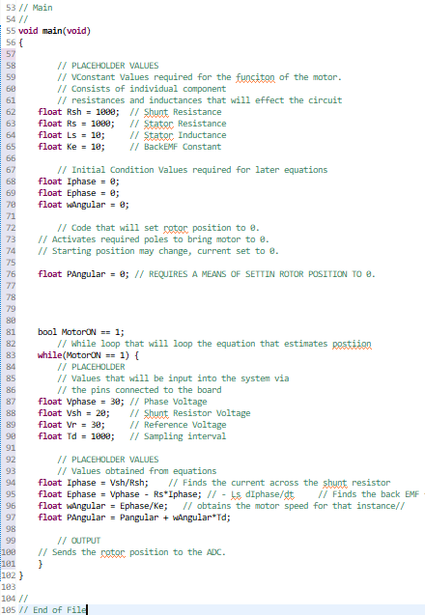
-Estimator-
John Adam Case King
Accomplishments since the last presentation <17> Hours | Ongoing progress/problems and plans until the next presentation
Outlined required components for the estimator Code function Wrote the ‘rough draft’ of the estimator code. (Bottom right corner) | Determine best way to loop the code. Understand code that will connect inputs and outputs to the estimator.
Constants:
Shunt Resistance
Stator Resistance
Stator Inductance
Back EMF Constant
Initial Condition:
Rotator Angular Position = 0
Equations:
Phase Current = Vsh/Rsh
backEMF = Vphase - Rs*Iphase - L dIphase/dt
Angular speed = Vb/Ke
Angular Position = previous position + td*w
Inputs:
Shunt Voltage
Reference Voltage
Phase Voltage
Sampling Interval Time
R
Output:
Updated Angular Position

Slide 10
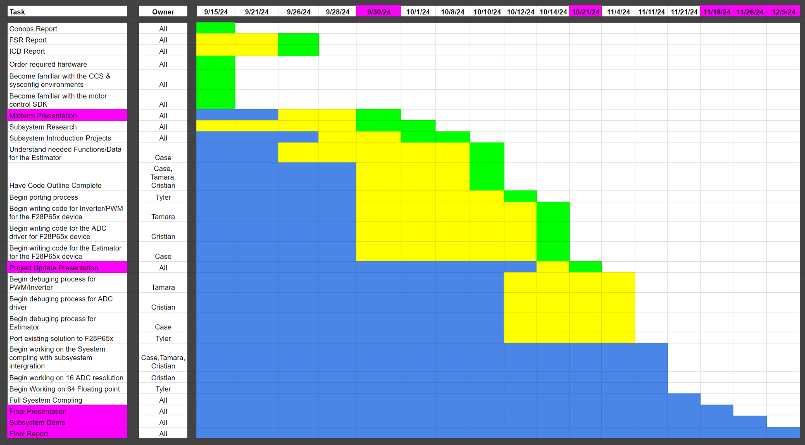
Execution plan
Notes:
Tyler

Slide 11
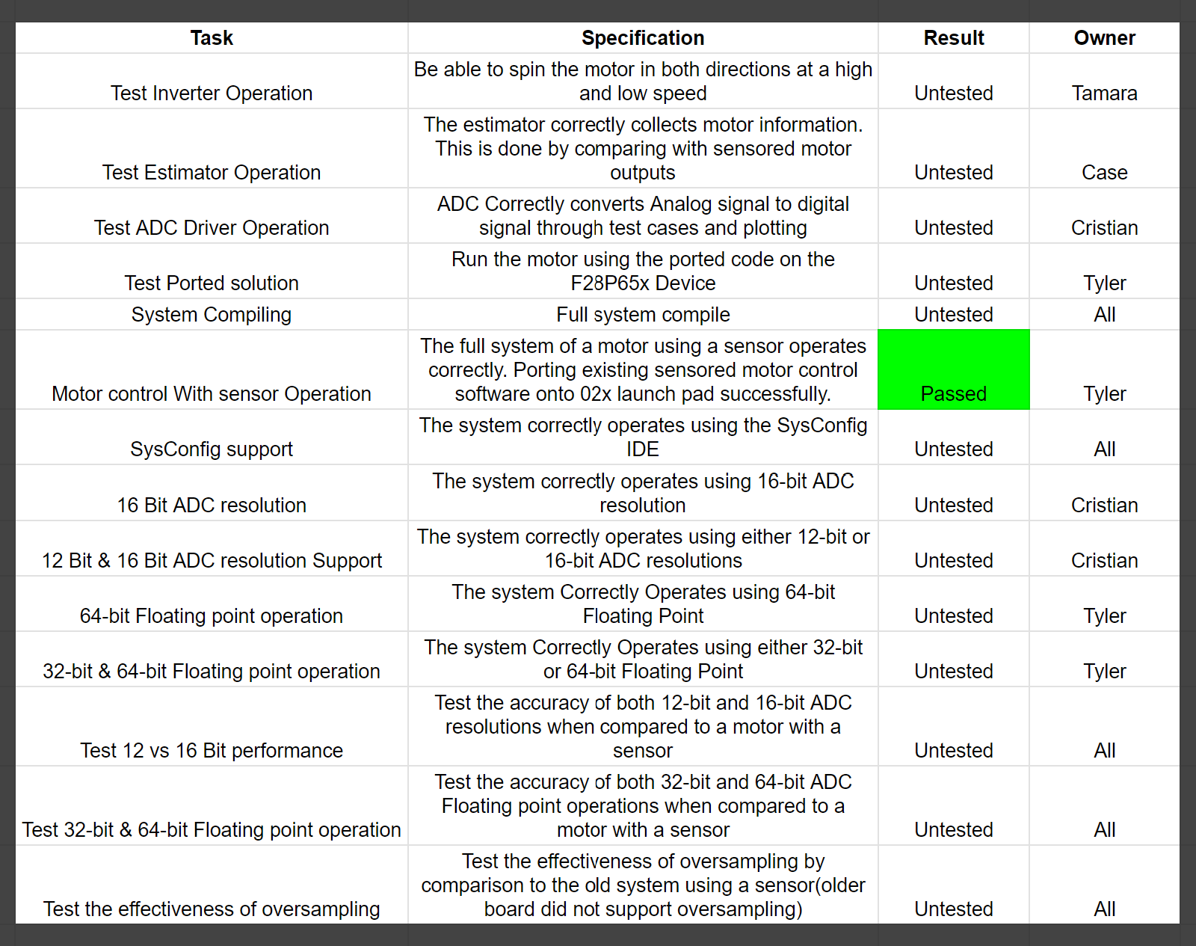
Validation plan
Notes:
Tyler

